Slide 1
Content Processing
Make you content Richer
There is nothing permanent except change. All is flux nothing stays still.
Heraclitus

Slide 2
Capabilities
There is nothing permanent except change. All is flux nothing stays still.
Heraclitus

Slide 3
Overview
We combines Human and computed AI platform to perform the function of Meta Tagging of the content.
While Automated programs can auto detect people, objects, scenes, emotions and activities in any video content and tag it with relevant information a human check is required to enhance the database and rationalise the comments. Either customer deploy their own staff, or we deploy our experienced staff to re-validate the and enhance the Metadata.
Group of creative writers put together Episodic synopsis and tags it with the content. We also work with a team who update the basic Meta-data fields required for the OTT.
Thus, providing a unique product using the best of the capabilities of Human intelligence and Machine learning AI
Based on the unique combination; we work with the Content Owners and platforms use rules based logics to identify logical points in the content (natural ad breaks, scene changes, mid roll points, credits, key moments), categorize videos and create searchable meta-data around their video content libraries and adds that as the content meta-data based on time codes

Slide 4
Overview
The System is to provide a single point to the content owners for end-to-end processing and value creation of the content of the use the power of Home working and utilizing the workforce who can only work part-time.
The Product is divided in to sub products and the customer can choose a combination of the products. The customer is charged only for the services chosen:
Limited metadata entry ( essential field only fields)
Complete metadata with time code and AI recognition
Non-live
Recognition and profiling details
Adverts and sales generation
Episodic synopsis / posters
Promo creation
The system is built on the concept on scalability. The customer can scale the volume based on their crusts and troughs.

Slide 5
Workflow
The system follows a simple and scalable workflow based on a combination of Cloud & Edge computing with secure connectivity.
The workflow is built based on the concept that the customer does not have to change any part of their working system and the enhancement sits seamlessly within their current structured processes.
All the customer facing process modules are web based.
During the complete Process, (excluding Promo creation), the customer content in the original format is never stored by us. The process is further explained in the section – Content Processing
The access to the content is only from a single defined IP.

Slide 6
On Boarding (customer)
On Boarding
At the time of on-boarding we will provide a login with administrative rights is created.
As part of the on-boarding the administrator will define multiple areas such as – which services are being bought by your company; what Mata-tagging field are required to be filled, flow of incoming data, content format and approval process etc. Once this is done the administrator will also create further login for your team and define the roles; access points and approval authorities for each member of the team.
The paths are set up for the customer content.
The formats are provided in which the appropriate data; content name and details are provided / agreed
While the system has a large database and methods for constant update, a small number of old content is run through the AI gateway for the AI system to learn the specifics of the customer content.

Slide 7
Content Processing
Content types which are recognised by the AI
Content Segment
People AI + Manually checked. Also where missed is added Manually
Objects (ability to keep adding types) AI
Time and credit sequences Manually
Titles and other customer specific data Manually
Signature tunes AI + Manually checked and if required corrected
Shot and Scenes AI + Manually checked and if required corrected
Value creation
Attire AI
Location AI
Banners
Show Banners AI + Manually checked
Channel Banners AI + Manually checked

Slide 8
Content and information flow
Database of the available authorized appropriate manpower
Creative Writers and entry persons will playout the content assigned to them
Supervisor Matches and assigns a job
Input data
Information and data regarding the
The data is stored in the database and marked for assignment
new arrival of content is sent
Customer content
Instructions to the transcoder
Transcoder
 | Transcoder & player
Low Res Storage
Transcoder initiates the download of the file and simultaneously performs:
Proxy / Low Res generation
Visible Watermarking of the Low Res
Storage of the Low-res in the DR secure storage
Holding Area for approval
Updated Content with Meta data
Has the customer ordered AI Meta tagging
 | AI Based Meta tagging process
Customer approval

Slide 9
Project Management workflow
Project / Resource Management
Search Freelancer
Assign Freelancer
Assign Work Order (task)
Assign media file
Track work order status
Function
Skill
Location
rate
Select from the drop down list
Add media to booking Check in check out
Task status from To do to In Progress and Done
Assign work order with a low res media file or a link to a media file

Slide 10
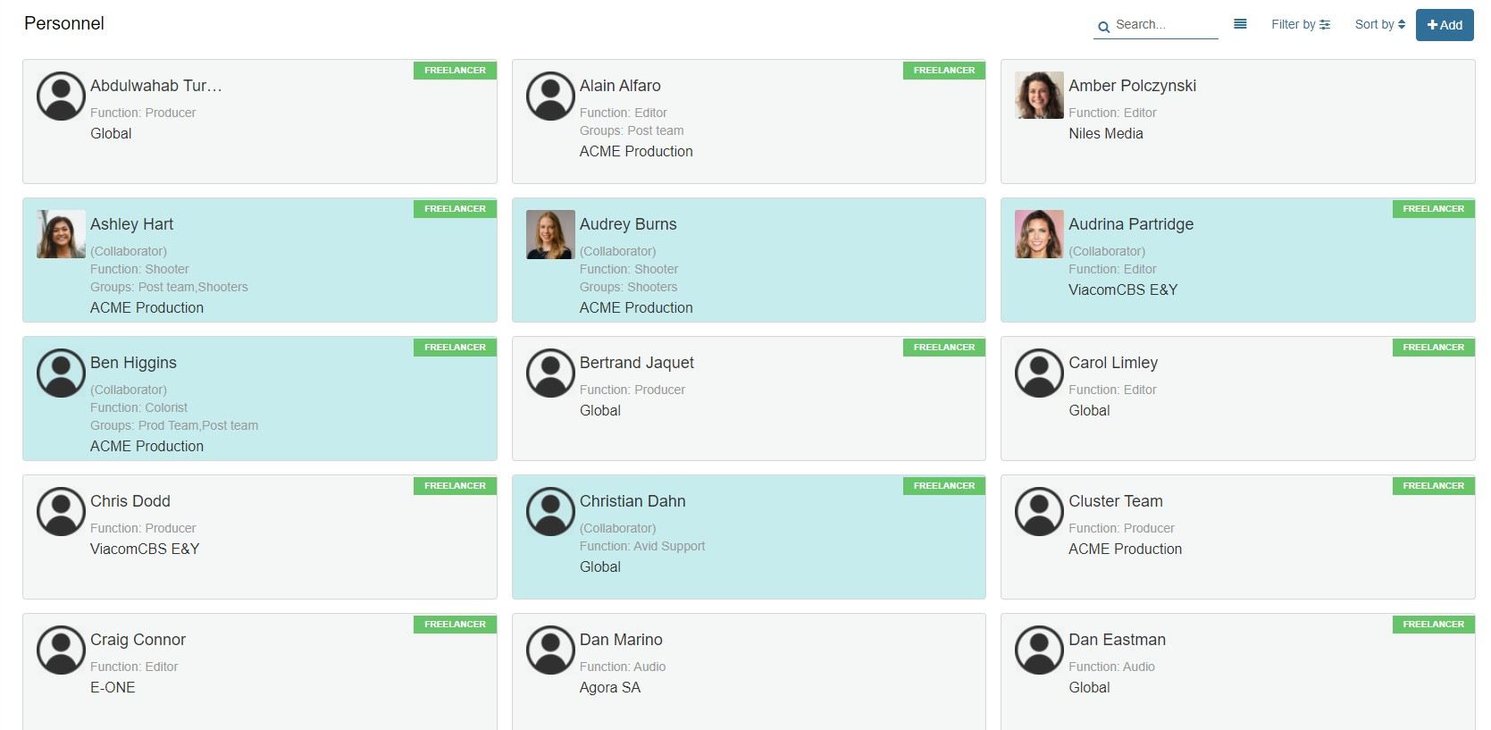
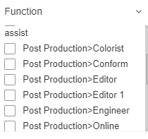
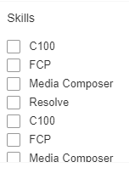
Workforce Database Management
filters
Location
Mumbai Singapore Jakarata

Slide 11
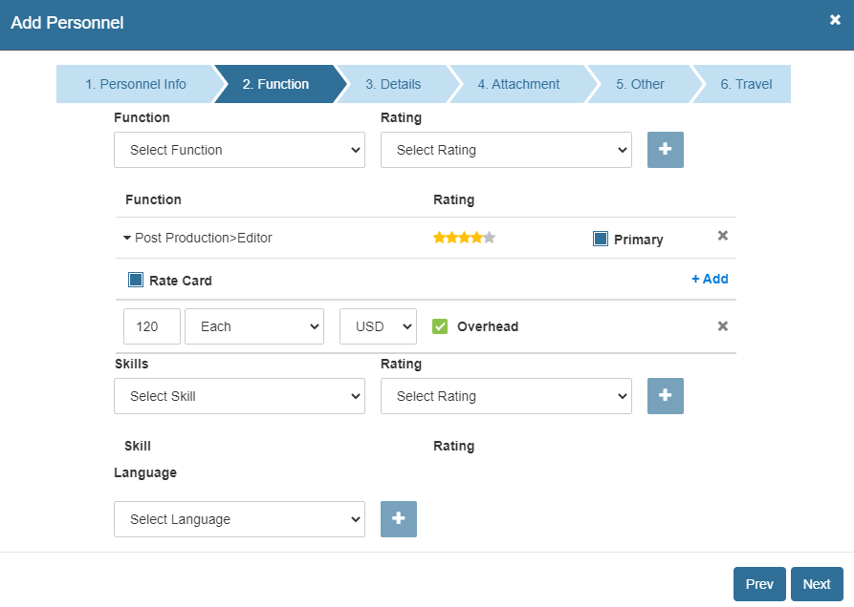
Add a new freelancer to the database
DB fields
Function(s)
Rate(s)
- by day, by project(s)
Location
Skills(s)
Proficiency
Availability
- Class A, B, C
Class A, B or C

Slide 12
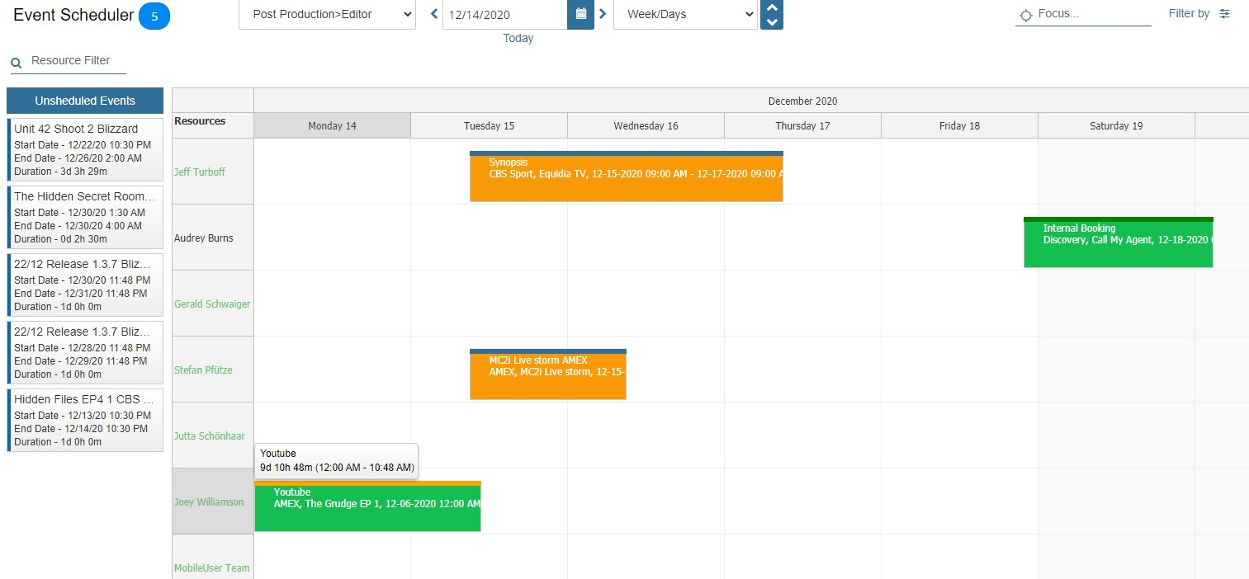
Assign a project to a freelancer with drag and drop
List of available Resources
Filter by:
Project
Client
Status
List of unassigned Projects

Slide 13
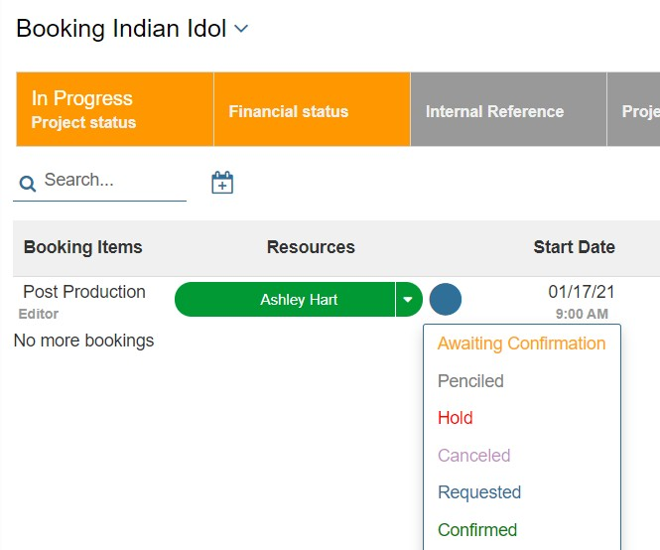
…or assign a project from a drop down list
Send project assignment notification to
Project
Crete work order
Select one of the available freelancers from the dropdown
Colour coded booking status (blue – requested by freelancer Green – confirmed by resource)

Slide 14
Video Reasoning Platform analyses Video to generate Knowledge
Enriched Visual Data
Scene Level Data
OTT Video
Process
Binge Markers
Ad Inventory
Output
Knowledge

Slide 15
AI based Software engine development
Software to process the file and generate the time-code based Meta-data file
Upload a file into the system
Enriched Visual Data
Scene Level Data
OTT Video
Process
Use the Knowledge and create more knowledge
Binge Markers
Generate the Knowledge learning (automated sources / manual input
Ad Inventory
Audio to Text
Knowledge
Output

Slide 16
What are we making ? Enriched Visual Metadata
Show Poster Banners
Show Poster Banners
Episode posters
Trailers
Casts
Celebrities
Placards, Cast & Celebrity profiles, topic pages all ensure much more time spent inside the product, discoverability of content (especially long tail).

Slide 17
What are we making ? Indexing
On pause button show people (like X-Ray)
Auto detect binge markers to skip segments
Meta-Tagging in scenes, Binge markers (title sequences and credits), Scenes with signature jingles, Logos.
Meta-tagging of Objects in Knowledge base: Cars, Mobiles, Laptops, Monitors, Buses, Bags, etc.

Slide 18
What are we making ? Profile Pages
All people, objects and logos discovered will have their own profile pages -
with links to their scenes, portraits and banners from diﬀerent shows.
Any available or verified metadata (from the Knowledge Graph, Wikipedia, Social Media etc) will be available in the profile pages. This is updated constantly through the ML accessing different sources. This list of sources is constantly updated by our team.
In addition there has to be a provision for our team will be constantly be updating the data base

Slide 19
What are we making ? Moments
Creation of Thumbnails, Auto Generated Highlights and Promos

Slide 20
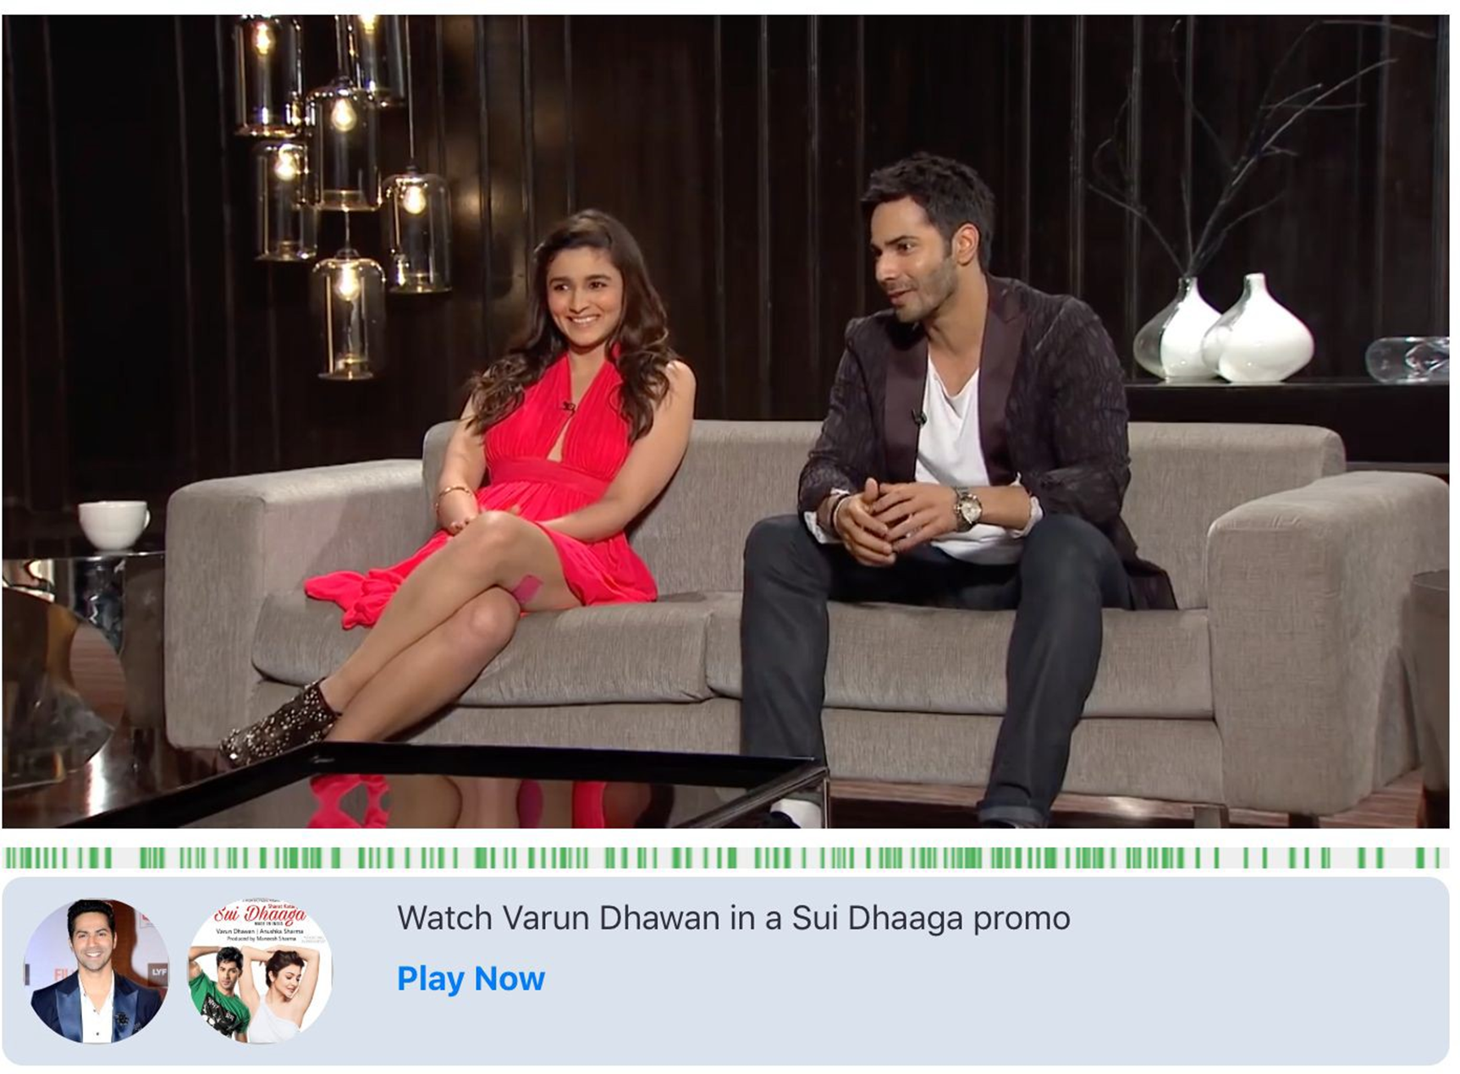
What are we making ? Moments
Ad Inventory with video moments
An engagement and targeting platform that can create augmented engagements when certain video moments pass by. The engagement targets can either be overlays on video, frames below the video, video inserts or other banner targets.

Slide 21
Thank you

